Slide 1

LifeSphere AI-An Intelligent Personal Life Management Platform
ASE Project Review-1
Date& Time
 | Under the Guidance of Ms. Lavanya Gottumukkala Assistant Professor, Department of Computer Science and Engineering, KLH CSE Bowrampet Campus
Team Members 2420030172 -Parvatha Reddy Satwika Reddy 2420030482 -Alla Sai Harsha 2420090064- B.V. Laxmana 2420090089- Beeram Guru Prasad Reddy

Slide 2
Outline of Project Work
Problem Statement
Objectives
Existing System
Challenges
System Workflow
Modules
Conclusion
Future Work

Slide 3
Problem Statement
Problem Statement
Managing important personal information such as documents, reminders, personal details, and emergency information is often scattered across different applications and storage locations.
Problems with the current approach
Important documents are stored in different locations.
Users have difficulty organizing personal information.
Reminders and important tasks are handled separately.
Emergency information may not be easily accessible.
There is no single platform combining personal management with AI assistance.
Security and controlled access to personal information are important concerns.
Our Problem
To develop a secure, centralized and intelligent platform for managing important personal information and documents.

Slide 4
Objectives
Objectives
Develop a centralized personal information management platform.
Provide secure user registration and login.
Protect user accounts using password hashing and JWT authentication.
Allow users to upload and manage important documents.
Provide document download and deletion functionality.
Provide a personalized dashboard.
Add reminder management.
Integrate an AI assistant for intelligent interaction.
Provide emergency-access functionality.
Maintain user-specific data security.
Main Goal
One secure platform for managing important aspects of personal life.

Slide 5
Existing System & Limitations
Existing System
Currently, users commonly depend on multiple applications:
Cloud Storage
Notes Apps
Calendar / Reminder Apps
Messaging Apps
Personal Files
Limitations
Information is distributed across multiple platforms.
Difficult to maintain everything in one place.
No unified personal dashboard.
Limited integration between documents, reminders and personal information.
Security mechanisms differ between applications.
AI-based personal assistance is generally not integrated with all personal management functions.

Slide 6
Proposed System
LifeSphere AI provides a centralized and secure platform for managing personal information, documents, reminders, and intelligent assistance.
Core Features
🔐 Secure Authentication – Provides secure registration, login, and JWT-based access control.
📊 Personalized Dashboard – Gives users a simple overview of their documents, reminders, and activities.
📄 Document Management – Allows users to upload, view, download, and delete important documents.
⏰ Reminder Management – Helps users create and manage reminders for important tasks and events.
🤖 AI Assistant – Provides natural-language interaction and intelligent assistance to users.
🚨 Emergency Access – Enables controlled sharing of selected important information during emergencies.
👤 User Profile – Allows users to view and manage their personal account information.
⚙️ Settings & Preferences – Provides options to customize the application according to user needs.
Benefits
• Centralized Information – Important personal information is managed in one platform.
• Secure Access – User data is protected through authentication and access control.

Slide 7
Technology Used
Layer | Technology
Frontend | React.js + Vite
UI | CSS + Lucide React
Backend | Java + Spring Boot
Database | MySQL
ORM | Spring Data JPA / Hibernate
Security | Spring Security + BCrypt + JWT
API | REST API
Development | VS Code / Eclipse
Build Tool | Maven
Runtime | Java 21
Future AI Service | Python
Future Deployment | Docker / Cloud

Slide 8
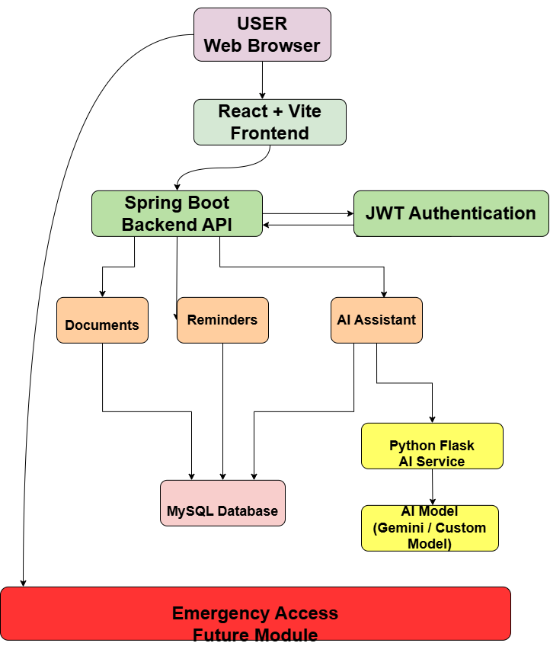
System Workflow

Slide 9
Modules
Module | Status | Description
User Authentication | ✅ Completed | Secure registration, login, JWT-based authentication and logout implemented.
Dashboard | ✅ Completed | Central dashboard showing documents, reminders and system status.
Document Management | ✅ Completed | Users can upload, view, download and delete personal documents securely.
Reminder Management | ✅ Completed | Users can create, view, complete and delete reminders with date and time.
AI Assistant | ✅ Completed | Chat interface created for interacting with the LifeSphere AI system.
AI Model Integration | ⏳ In Progress | Connecting the Python AI service with a real language model.
Document AI / RAG | ⏳ Planned | AI will retrieve relevant information from uploaded documents to answer user queries.
Custom AI Model | ⏳ Planned | Future fine-tuning of an open-source model for LifeSphere-specific tasks.

Slide 10
Implementation Progress
Frontend
✅ React + Vite Setup – Modern and fast frontend development environment.
✅ Login & Registration – User authentication interface for secure account access.
✅ Dashboard – Provides a centralized overview of LifeSphere features and activities.
✅ Profile – Displays and manages basic user information.
✅ Settings – Provides application preferences and customization options.
✅ Dark/Light Mode – Allows users to switch between different visual themes.
✅ Documents Interface – Provides an easy-to-use interface for managing personal documents.

Slide 11
Implementation Progress
Backend
✅ Spring Boot Setup – Provides the REST API and core backend services.
✅ MySQL Integration – Stores user and application data securely.
✅ User Management – Handles user registration and account information.
✅ Authentication APIs – Supports secure registration and login operations.
✅ BCrypt Password Hashing – Protects user passwords using secure hashing.
✅ JWT Authentication – Maintains secure user sessions through tokens.
✅ Protected APIs – Restricts sensitive operations to authenticated users.
✅ User Profile API – Retrieves information of the currently logged-in user.
✅ Document APIs – Handles document upload, retrieval, download, and deletion.

Slide 12
Implementation Progress
• Document Management
✅ Upload – Allows users to securely upload supported documents.
✅ List Documents – Displays documents belonging to the logged-in user.
✅ Download – Allows users to retrieve their stored documents.
✅ Delete – Removes unwanted documents from the system.
✅ User-Specific Access – Ensures users can access only their own documents.
• AI Service
⏳ Python AI Service – Separate AI layer developed using Flask.
⏳ Backend Integration – Connected with Spring Boot for AI request processing.
⏳ AI Model Integration – Integration with a real language model is in progress.
⏳ Document Intelligence – Planned to enable AI-based understanding of uploaded documents.
⏳ RAG & Custom AI – Planned for document-aware responses and LifeSphere-specific AI capabilities.

Slide 13
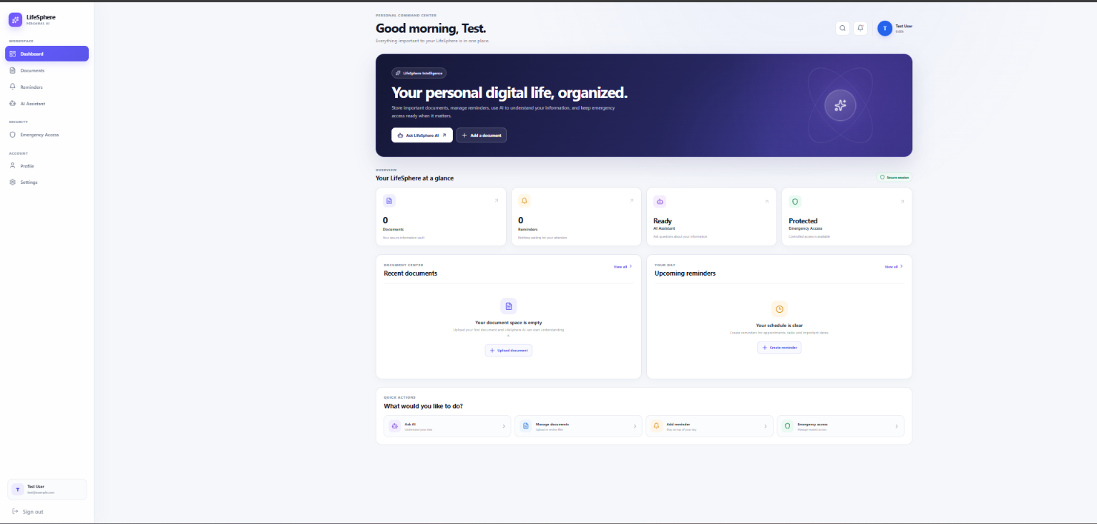
Working Module Screenshots
Screenshot 1:Dashboard

Slide 14
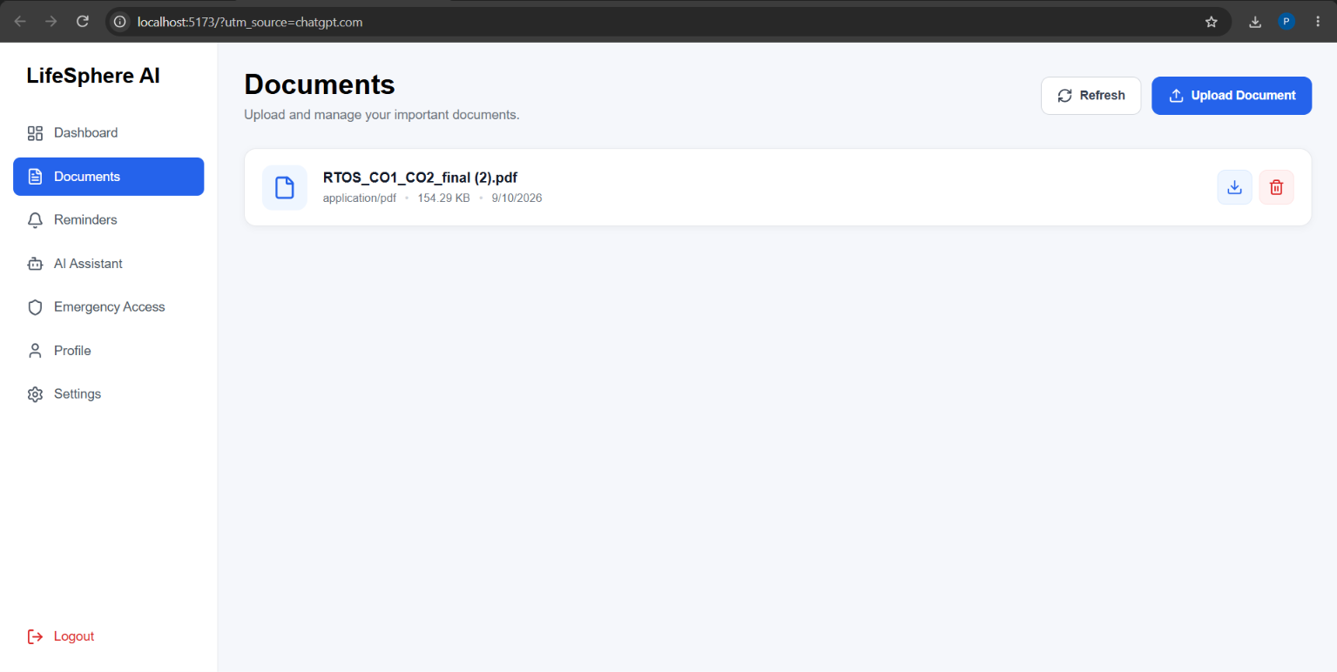
Working Module Screenshots
Screenshot 2:Documents

Slide 15
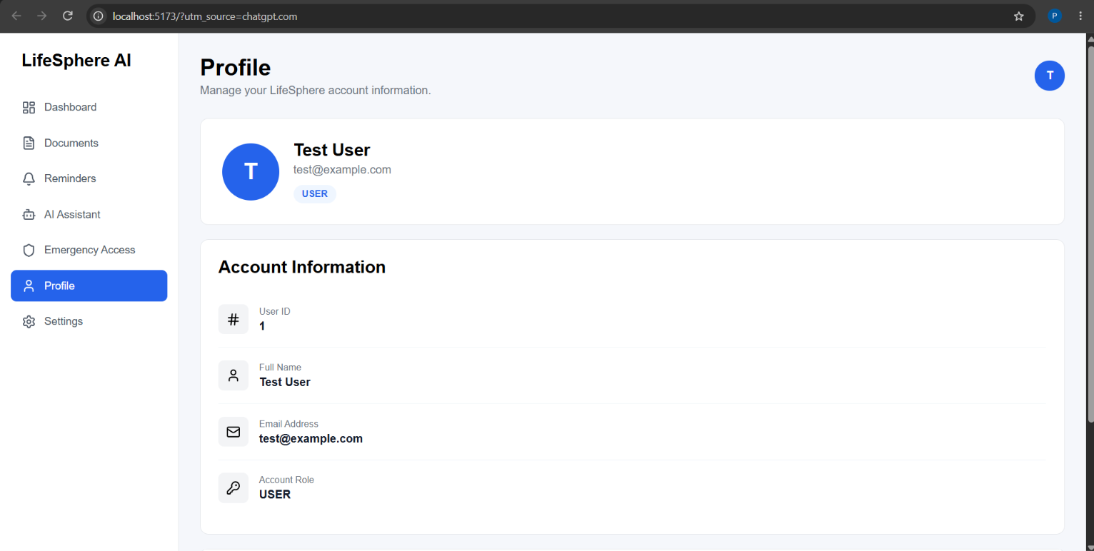
Working Module Screenshots
Screenshot 3:Profile / Settings

Slide 16
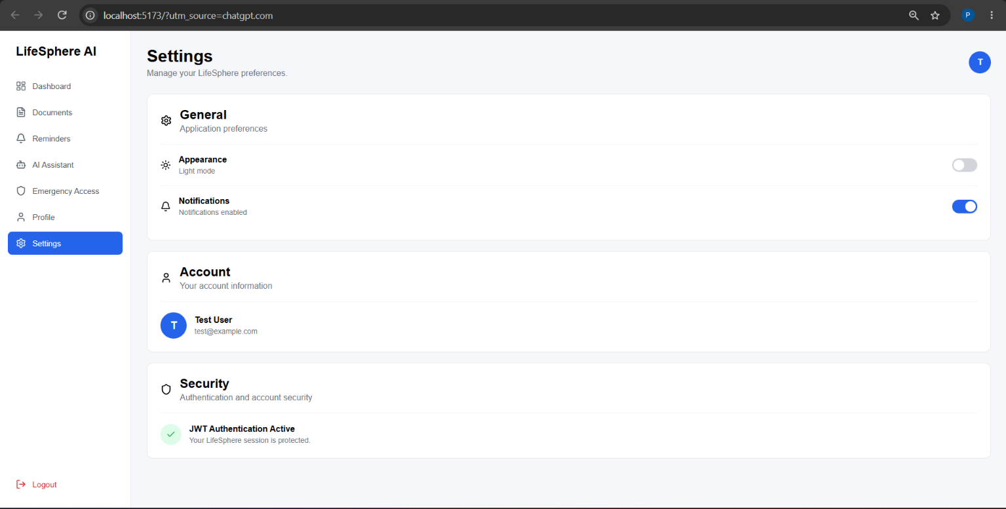
Working Module Screenshots
Screenshot 4:Profile / Settings

Slide 17
Conclusion
Conclusion
LifeSphere AI has successfully established the core foundation of a secure and personalized life-management platform. The major application modules have been implemented and integrated, providing a strong foundation for future intelligent features.
Currently Working
✅ User Registration – New users can create their LifeSphere accounts.
✅ Secure Login – Authenticated users can securely access the application.
✅ JWT Authentication – Token-based authentication protects user sessions and APIs.
✅ Personalized Dashboard – Provides a centralized view of the user's LifeSphere activities.
✅ Profile & Settings – Allows users to view profile information and customize preferences.
✅ Document Management – Users can upload, list, download, and delete their documents.
✅ User-Specific Security – Documents and protected resources are restricted to their respective users.
✅ Reminders – Users can create, view, complete, and delete personal reminders.

Slide 18
Future Scope
Future Scope
🤖 AI Assistant
Intelligent personal assistance
Natural-language interaction
Integration with a real AI model
📄 AI-Powered Documents
Automatic document understanding
Document-based question answering
RAG-based information retrieval
🧠 Custom AI Model
LifeSphere-specific AI customization
Fine-tuning of an open-source model
Personalized AI responses
🚨 Emergency Access
Secure emergency information sharing
Controlled access to important information
🔐 Advanced Security
Improved access control
Additional privacy and security mechanisms
☁️ Deployment
Docker containerization
Cloud deployment
Scalable backend and AI services
📱 Future Enhancement
Mobile-friendly improvements
Potential mobile application support
Final Statement:
LifeSphere AI currently provides a functional foundation for personal information and task management, with AI-powered intelligence and advanced features planned as the next phase of development.

